Slide 1
Test plan discussion
Optical Microscope

Slide 2
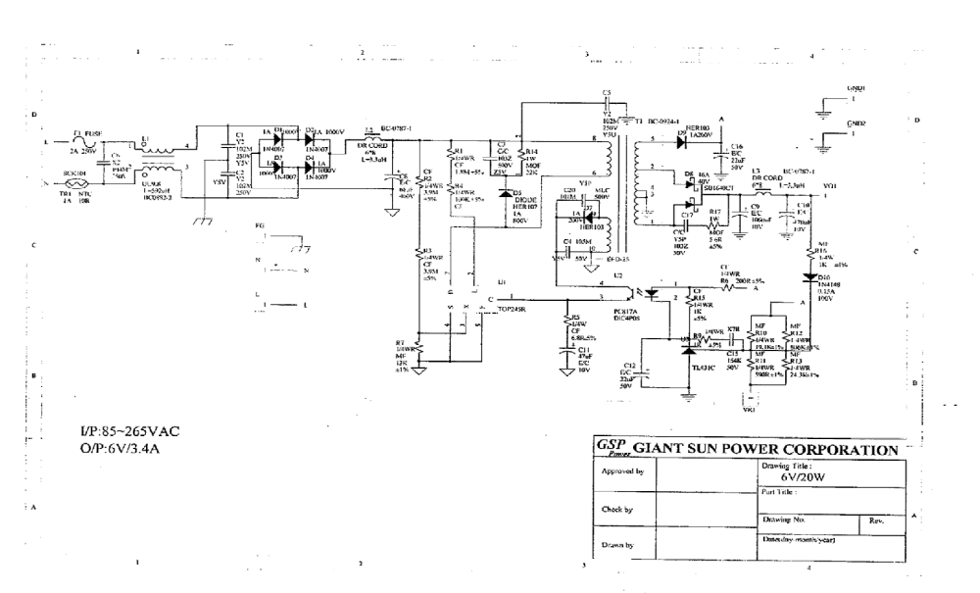
Circuit Diagram

Slide 3
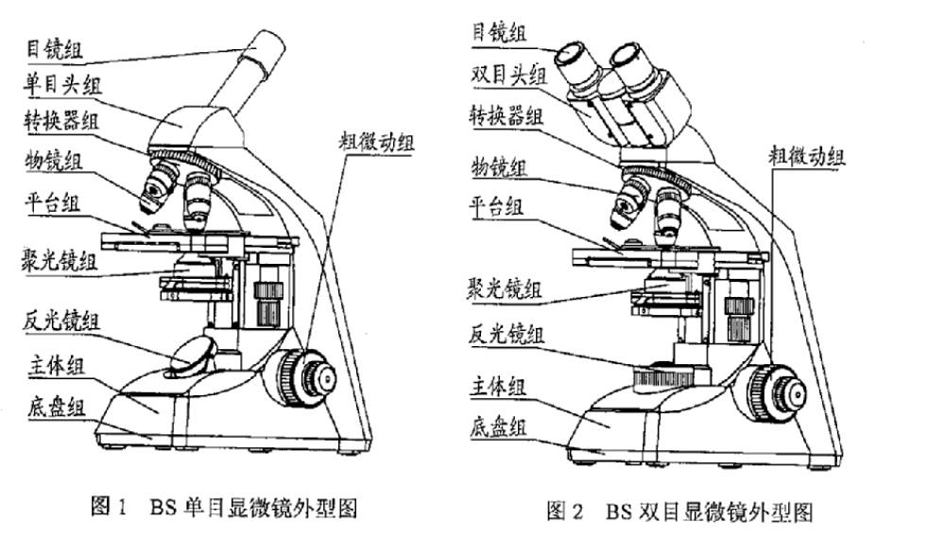
Additional information- program chart

Slide 4
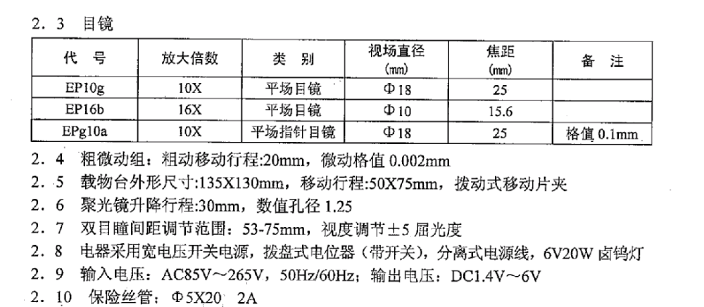
Additional information- program chart

Slide 5
Disturbance Source
Triac controlling the motor + controlling program --- click
Relay controlling the heater + controlling program --- click
DC motor --- broadband disturbance
Crystal --- narrow band disturbance
Heater + relay + controlling program --- Flicker

Slide 6
Sensitive components for immunity test
LCD Display IC
Main controlling IC

Slide 7
Applicable standards
EN61326:1997+A1+A2
EN 55015:2000+A1+A2
EN 61547: 1995+A1
EN 61000-3-2:2000
EN 61000-3-3:1995+A1

Slide 8
Test items/operation modes
Disturbance voltage(9kHz-30MHz of EN55015)
  operation mode: adjust the light to cause max. emission
Disturbance voltage(9kHz-30MHz of EN 55015)
  operation mode: adjust the light to cause max. emission
Click(150kHz-30MHz of EN 61326)
  Not applied
Disturbance voltage(150kHz-30MHz of EN 61326)
  operation mode: adjust the light to cause max. emission
Radiated emission(30MHz-1000MHz)
  Same as above
Harmonic(Class A)
  Same as above

Slide 9
Test items/operation modes
Harmonics
  Adjust to cause max. emission
Flicker
  Deem to pass
ESD
  According to the sensitive component, two IC should be running during testing. Any of the program; 20% , 60%, 100% LUMINIOUS
EFT
  Same as ESD; 20% , 60%, 100% LUMINIOUS
CS
  Same as ESD; 20% , 60%, 100% LUMINIOUS
Surge(L-N:500V, and 1000V)
  Same as ESD
Dips
  Same as ESD
RS
  Same as ESD

